Slide 1

Coordinator Orientation
(Grades 9-12)
2025-2026

Slide 2

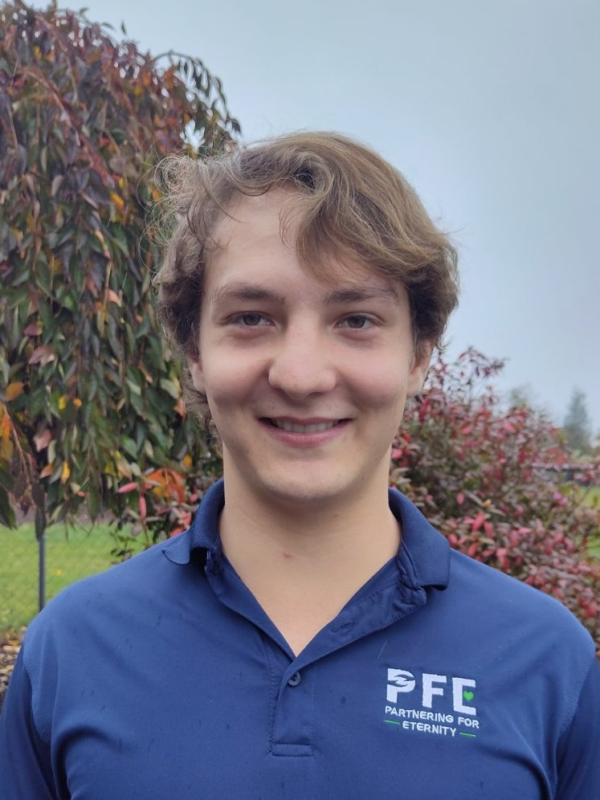
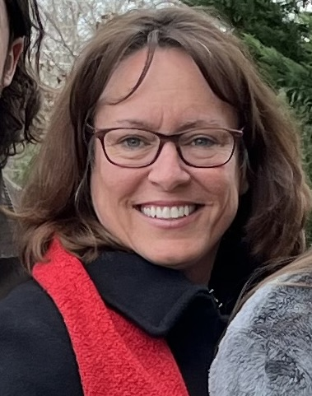
A family foundation whose current initiatives include:
PFE Scholarship * Nourish Grants for individuals/families * TCH Scholarship
Our Team
Levi Renner
PFE K-8 Program Manager
lrenner@sffcfoundation.org
Jackie Downs
TCH and PFE 9-12 Programs Manager
jdowns@sffcfoundation.org
Office: pfe@sffcfoundation.org

Slide 3

Legacy Video
Play

Slide 4
PFE Goals
Ease isolation and loneliness of the elderly by promoting connection.
01
For students and mentors to create intergenerational relationships and experience the blessing of service.
02
Support Adventist Education by awarding tuition scholarship
03

Slide 5
Coordinator
Role
Select student participants for PFE programming
Provide student/parent orientation (PowerPoint provided)
Provide mentors with orientation. (PowerPoint provided)
Review reflections weekly-provide needed feedback to student
Monthly check-ins with all mentors
Communicate with SFFC Foundation as needed

Slide 6
Choosing your PFE participants
Students and parents who are passionate about serving others.
Students who may be lacking a positive intergenerational connection.
Students/parents able to commit to consistent weekly 2-hour visits.
PFE is not a financially needs-based program.

Slide 7
Student/Parent Orientation
Students and parents must attend orientation prior to visits beginning. (even if they have participated in previous years)
Orientation must explain
Expectations of students in PFE programming.
The importance of choosing the correct mentor.
The mentor visits and reflection process
Eligibility/ineligibility for receiving scholarship (all or nothing)

Slide 8
Student-Mentor Matches
The goal is to facilitate reciprocal friendships between students and older adults (55+ recommended), or someone with a physical disability (could include someone younger than 40).
    Mentor Requirements
  Cognitively healthy
  Does not have plans to travel for extended periods of time
  Does not reside in a nursing home
  Is not be related to their mentee by any degree
  Adults younger than 40 must have a physical disability to qualify as a mentor.
  Mentor may only be paired with 1 student

Slide 9
Mentor Orientation and
Check-ins
Mentor’s information on student’s application must be complete and correct prior to approval of application as this is where you get the mentor’s contact information.
Mentors will automatically receive a Mentor Survey via email once their student’s application is approved
All mentors must complete Mentor Orientation with the PFE coordinator prior to a student’s application being approved and before students start visiting.
If possible, include mentors in your student/parent orientation
Check in with your mentors monthly to assure visits are successful.

Slide 10

Keeping each student safe while visiting
Parents of students in grades 9-12 will decide if their child may visit their mentor unsupervised.
Parents are ultimately responsible for their child’s safety
Parents are responsible for transportation to/from visit

Slide 11

PFE Visits
Acceptable
Playing board games or sports together
Teaching your mentor about technology
Helping your mentor grocery shop or clean house
Visiting a museum together
Eating at a restaurant or picnic
Baking
Unacceptable
Watching TV/Movie
Using your phone for personal reasons
Visiting your mentor’s home while they are absent
Virtual Visits
Sabbath Visits
Church or School events
Visits at mentor’s place of employment

Slide 12
Reflections
Should be submitted the last 5 minutes of each visit
Late reflections not allowed and should be rejected
Submit via phone app or online via computer
Email and Text notification of successful submission
No email or text = reflection did not submit.
Any tech issues:
students are to notify you at the time there is an issue.
Late notifications will not be an approved excuse for late submissions.
Disposition reflections weekly, giving feedback as appropriate

Slide 13

Dates and Deadlines
Fall Term Spring Term
Visit Dates: 8/17-12/31 1/1-5/15
Disposition Reflections: 1/6 5/18
Scholarship Processed: 1/8 5/19
Coordinator Surveys 5/1/26

Slide 14
PFE Scholarship
$800/Term for each PFE student who completes their requirements
SFFC pays 70% ($560)
Locally fundraised 30% ($240)
PFE website tracks approved reflections for scholarship
No partial scholarships awarded

Slide 15
Getting Started
Attend Coordinator Orientation
Select PFE Participants
Participants submit PFE application online
Contact mentor to arrange/attend Mentor Orientation
Provide Parent/Student orientation
Approve PFE participant application
Students can begin visits
Review Reflections weekly (minimum)

Slide 16
PFE Resources sffcfoundation.org/pfe
PowerPoint Presentations:
Orientations (Mentor, Student/Parent, Coordinator)
Loss of Mentor (when a mentor dies)
Information Packets
Coordinator, Student, Mentor
Ideas for student and mentors for visit activities

Slide 17

Social Media
PFE eNewsletter
Sent monthly via email to share stories, activity ideas, and upcoming dates
Can be found at https://sffcfoundation.org/pfe/news
Facebook Page: Partnering for Eternity
Request to join our FB page.
With parental permission, please post your great PFE stories and pictures

